Slide 1
From Layers to Load
Manual Fabrication and Mechanical Insights of Glass Fiber-Flax–Epoxy Composites
Our team
Ritesh Gupta (244103227)
Upendra Sharma (244103230)
Premkumar Elthuri (244103206)
K. Bhanu Prakash (244103218)

Slide 2
Introduction
Composite materials
Made from two or more distinct materials.
Offer strength, durability, and lightness.
Used in transport, construction, aerospace.
Importance of fiber-
reinforced polymers
Combine polymer matrix with strong fibers.
Provide high strength-to-weight ratio.
Resistant to corrosion and fatigue.

Slide 3
Introduction
Applications
Found in wind blades, boats, seat structures, Interior panels, dashboards, audio systems.
Used for both structural and cosmetic parts
Glass Fiber adds strength, flax improves impact resistance and reduces weight
Objectives
Show hand lay-up fabrication process
Share test results and insights
Highlight performance based on material layering

Slide 4
Material Selection
Glass Fiber : Adds strength without adding much weight Handles high temperatures
Flax : Helps reduce weight in composites Strong enough for many structural uses
Epoxy resin : Maintains dimensional stability during curing Adds stiffness and durability to composites

Slide 5
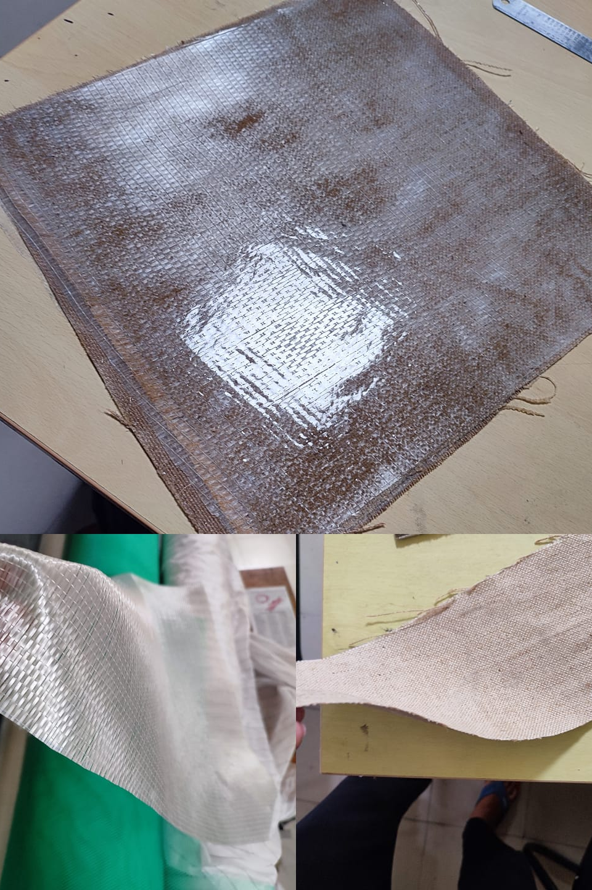
Why These Materials?
Synergistic properties when combined
Availability and cost-effectiveness
Suitable for hand lay-up techniques

Slide 6
Fabrication Method - Hand Lay-Up
Step-by-step process:
1. Mold preparation
2.Cutting Reinforcement material
3. Resin mixing and Application
4. Repeat layering
5. Consolidation
6. Curing Process
7.Tensile test and flexural test
Visual: Process diagram or images
Notes:
The lay-up fabrication method is commonly used in composite manufacturing, especially for producing parts from fiber-reinforced plastics like fiberglass or carbon fiber. Here's a step-by-step breakdown of the lay-up process:---Step-by-Step Process of Lay-Up Method1. Mold PreparationClean the mold to remove dust or debris.Apply release agent (like wax or PVA) to ensure the composite does not stick to the mold.Sometimes a gel coat is applied first to improve surface finish.2. Cutting Reinforcement MaterialCut fiberglass, carbon fiber, or other reinforcement fabrics to match the mold size and shape.Pre-cutting ensures easy handling and better layering.3. Placement of Reinforcement LayersLay the fabric manually or using semi-automated methods onto the mold surface.Align fibers in the desired direction to achieve required strength and stiffness.4. Resin ApplicationApply resin (e.g., epoxy, polyester) over the reinforcement layers using a brush, roller, or spray.Ensure proper impregnation of resin into the fibers.5. ConsolidationUse rollers or squeegees to remove air bubbles and ensure full wet-out of the fibers.Stack multiple layers as needed for thickness.6. CuringAllow the composite to cure at room temperature or in an oven depending on the resin system.Curing time varies based on resin type and environmental conditions.7. DemoldingOnce cured, carefully remove the composite part from the mold.8. Trimming and FinishingTrim excess material, perform sanding or machining to get the final shape.Apply surface coatings if required.---Types of Lay-UpHand Lay-Up: Manual process, simple and cost-effective.Spray Lay-Up: Uses spray guns to apply resin and chopped fibers simultaneously.

Slide 7

Key Parameters During Fabrication
Layer orientation
Resin-to-fiber ratio
Curing time and temperature
Importance of eliminating air bubbles

Slide 8
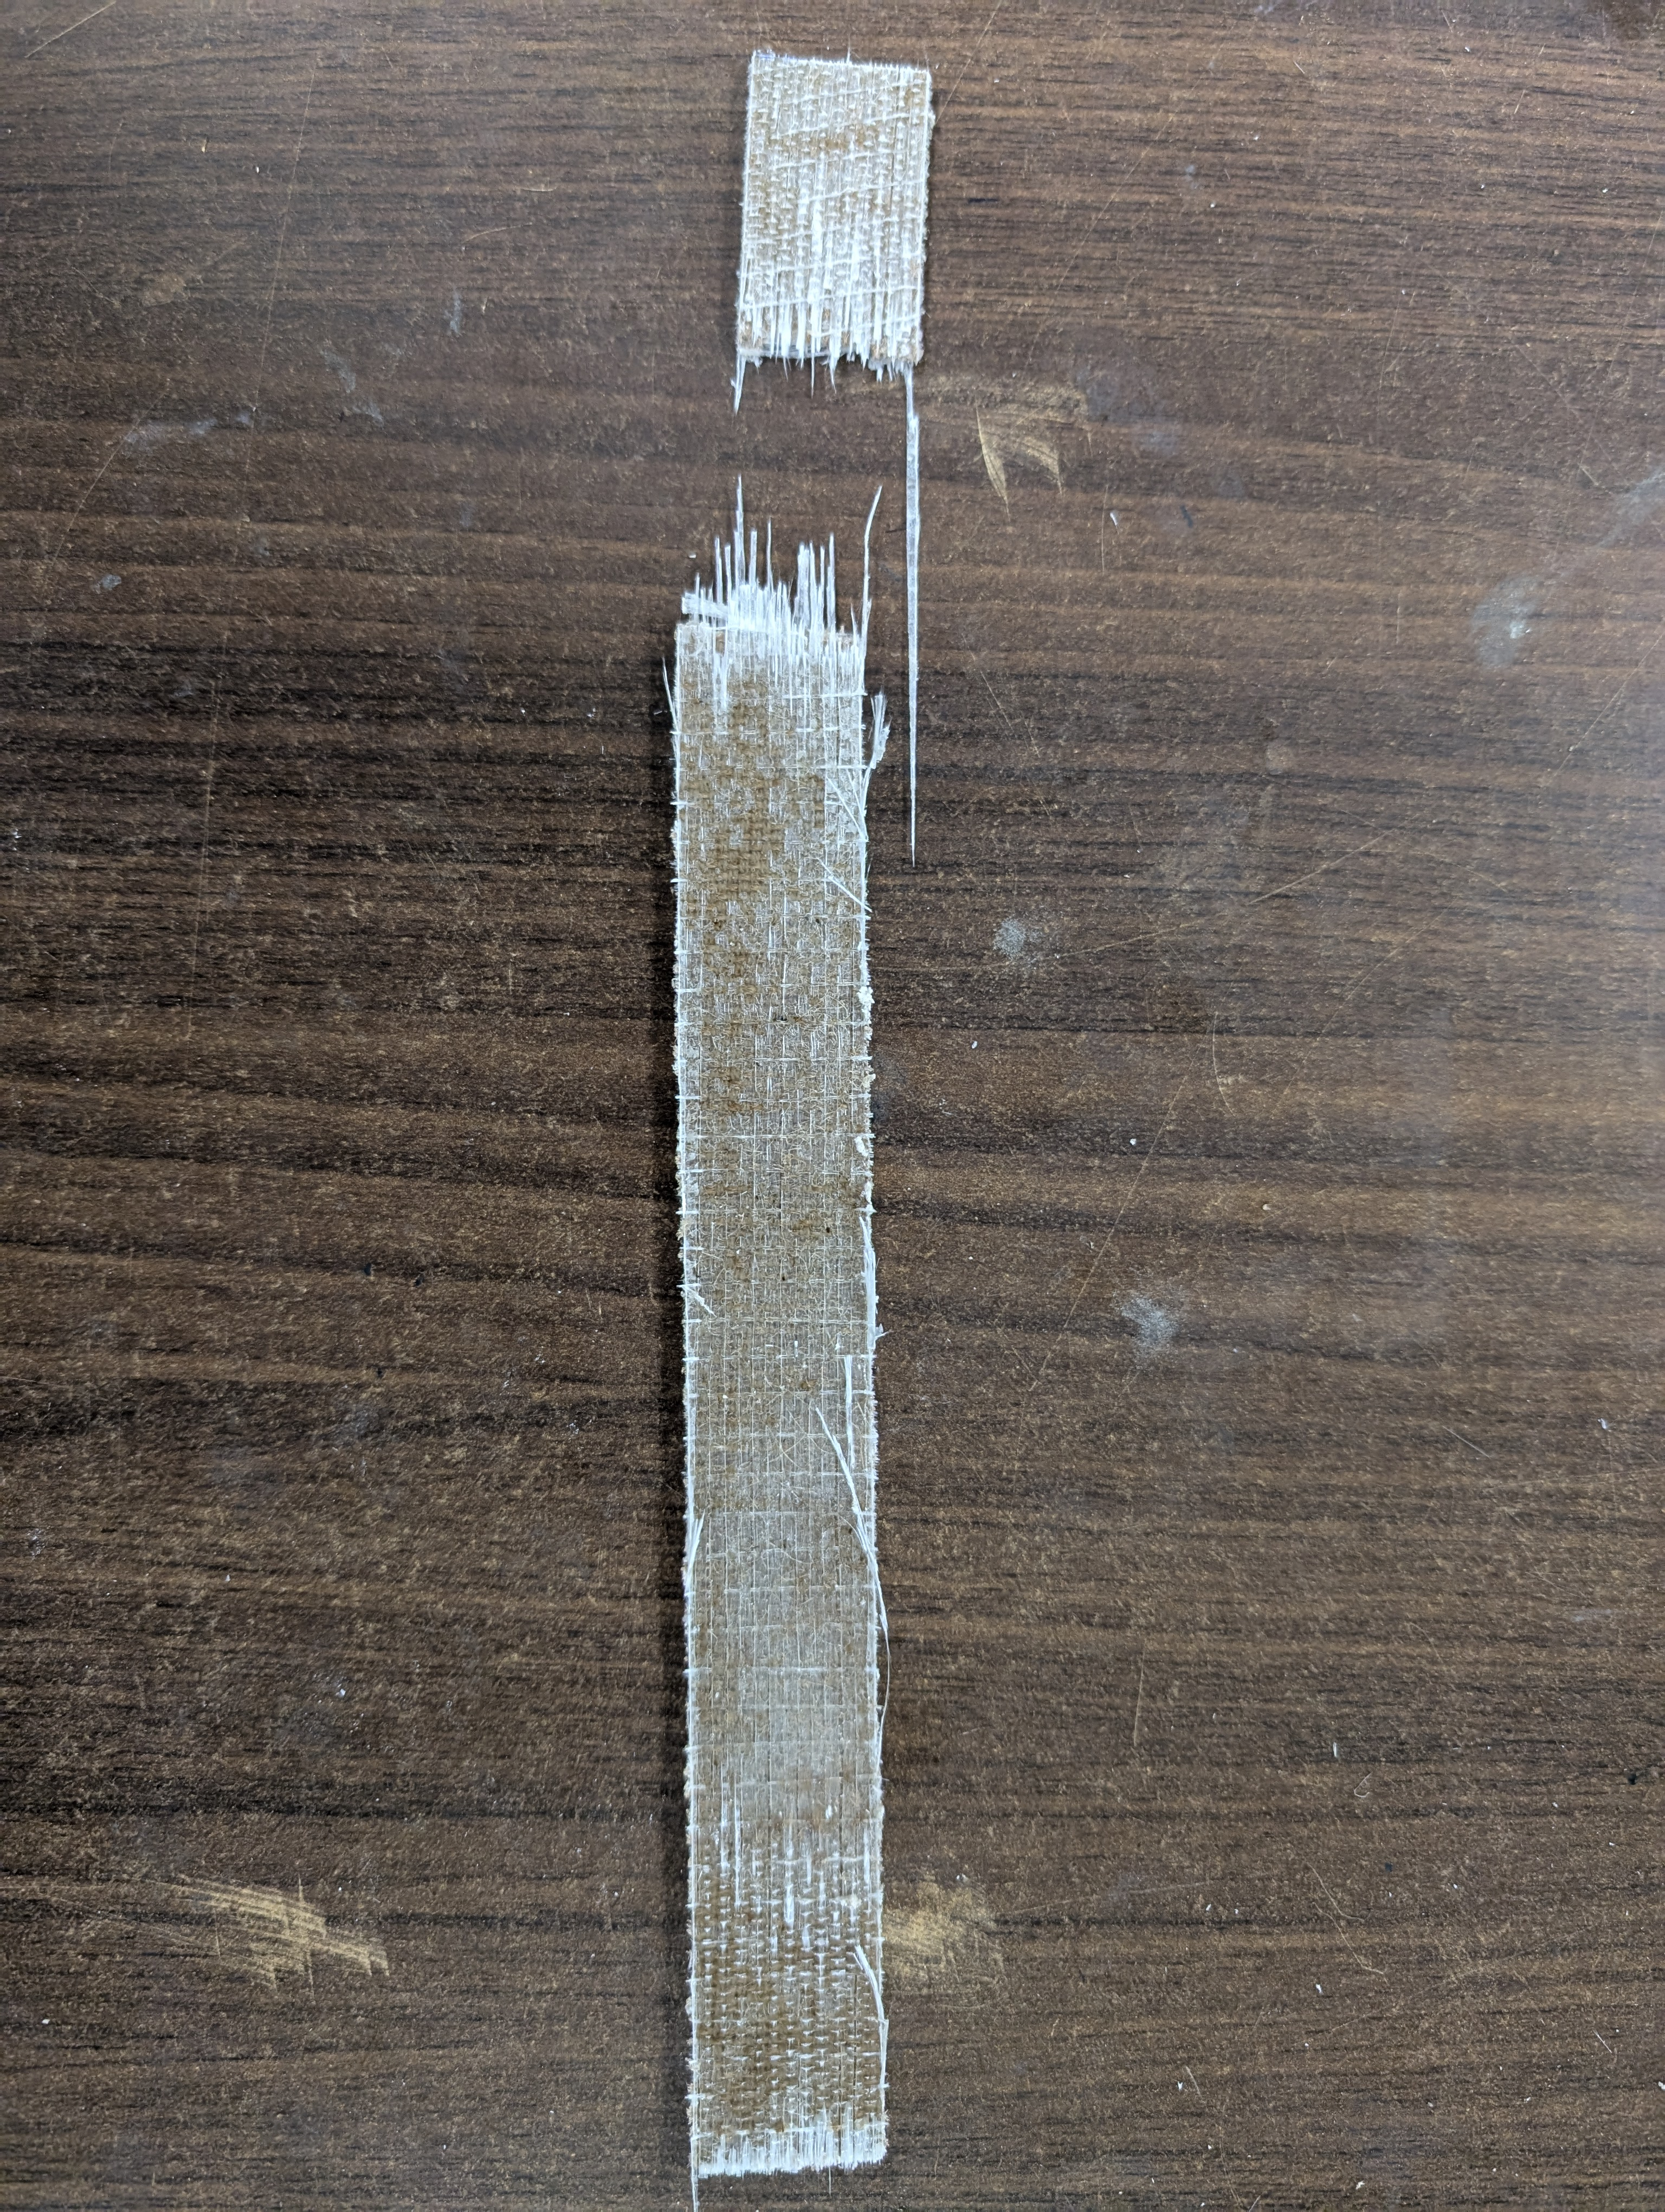
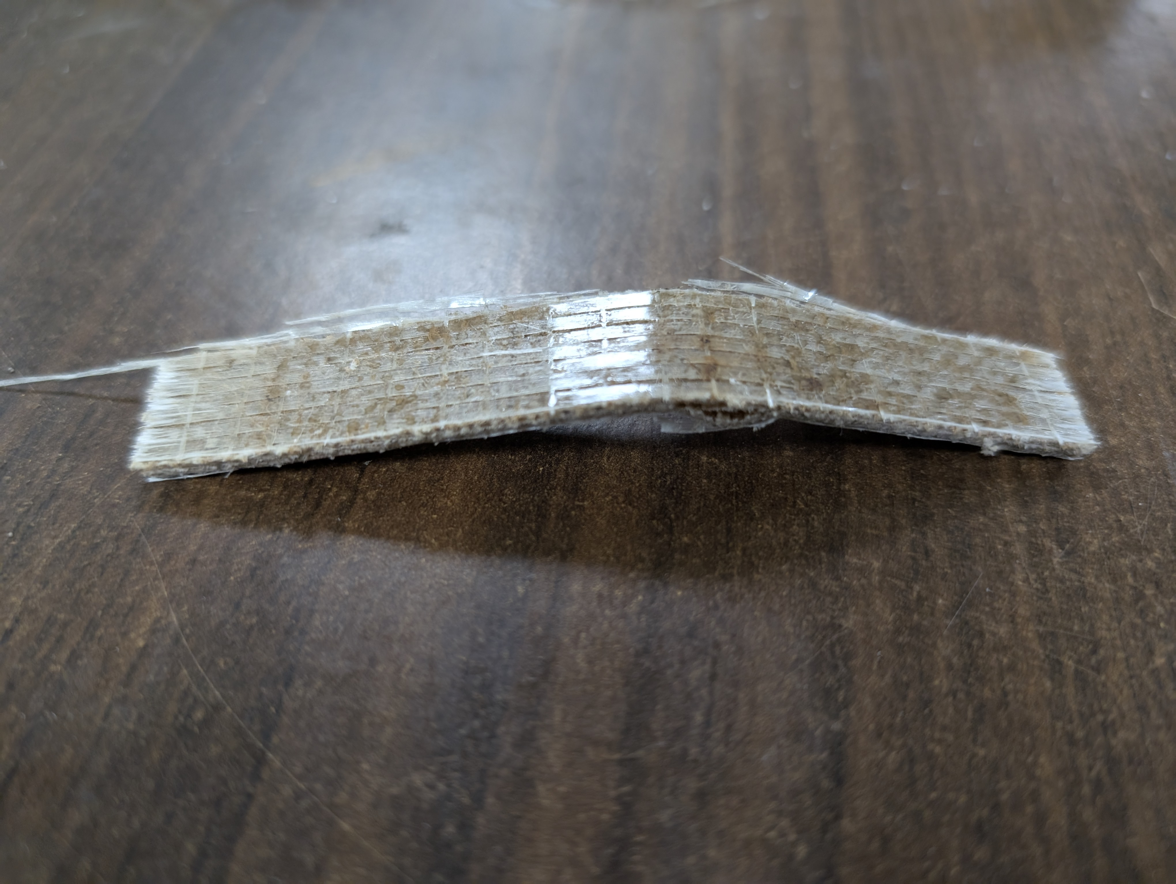
Testing and Mechanical Analysis
Need for Characterization
Tensile Test Failure
Aids in Failure Analysis and Material Development
Supports Design and Material Selection
Enables Accurate Design and Life Prediction
Facilitates Quality Control and Regulatory Compliance
Flexural Test Failure
Notes:
Hello everyone, I am Upendra Sharma. Today I'll be discussing our mechanical characterization study of composite materials manufactured using the hand layup process. Material characterization is really important because it
Aids in Failure Analysis and Material Development It allows for the identification of failure modes, supports the development of new composites, and improves existing materials by understanding their behavior under different conditions
Supports Design and Material Selection It provides essential data on mechanical and physical properties, enabling engineers to select appropriate materials and optimize designs for strength, stiffness, and durability.
Enables Accurate Design and Life Prediction Characterization supplies engineers with precise property data (such as strength, stiffness, and durability), which is crucial for accurate modeling, structural analysis, and predicting the lifespan of components
Facilitates Quality Control and Regulatory Compliance Regular characterization ensures consistent manufacturing quality, helps detect defects or inconsistencies, and supports compliance with industry standards and specifications
We performed 2 tests for the characterization. On right side we can see Tensile test failure and Flexural test failure of our material

Slide 9
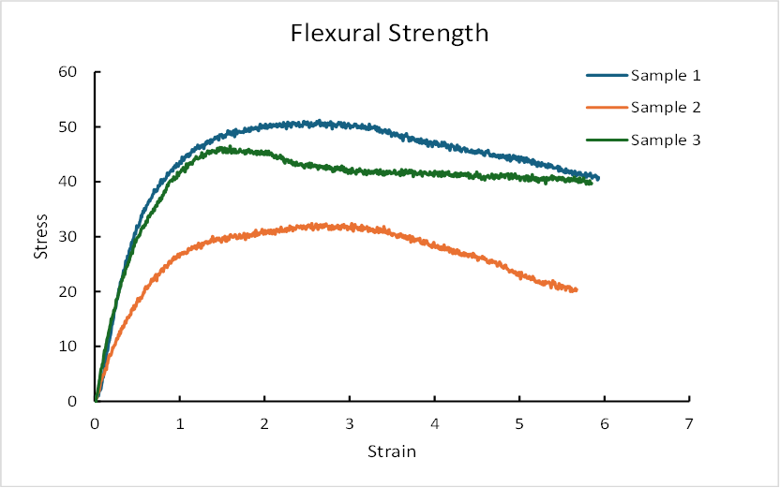
Results and Discussion
Tensile Strength Observations
Elastic behaviour and brittle failure
Considerable Variation
Flexural Strength Observations
Ductile failure behaviour
Why sample 2 have such high variation?
Implications of Hand Layup Process
Resin distribution, Fiber alignment
Air entrapment
Notes:
Introduction to Testing
These graphs show the flexural and tensile strength test results for composites fabricated using the hand layup process. Three samples were tested for each property.
Tensile Strength Observations
The tensile strength graph shows that Sample 1 again performs best, achieving the highest ultimate tensile stress, followed by Sample 2 and then Sample 3. The stress-strain curves are linear up to the peak, indicating elastic behavior, followed by a sudden drop, which is characteristic of brittle fracture in composites.
Flexural Strength Observations
In the flexural strength graph, Sample 1 exhibits the highest maximum stress, reaching just above 50 units, followed by Sample 3 and then Sample 2. This indicates that Sample 1 has the best resistance to bending forces, while Sample 2 is the weakest. All samples show a peak followed by a gradual decrease in stress, suggesting ductile failure behavior after reaching maximum load.
Implications for Hand Layup Process
The variation in results among the samples highlights the influence of the hand layup process on material properties. Inconsistencies in resin distribution, fiber alignment, or air entrapment during manual fabrication can lead to significant differences in mechanical performance. This underlines the need for careful process control and possibly further optimization if uniformity and high strength are required for engineering applications.
Overall, these results demonstrate both the potential and the variability of hand layup composites. For engineering and research, such characterization is essential to understand material behavior, guide process improvements, and ensure that the composites meet the necessary performance standards.

Slide 10
Thank You

